Slide 1


iBuyer
The Worst Thing To Happen To Homeowners
  www.ThePowerProgram.com | 631-929-5555

Slide 2





Slide 3
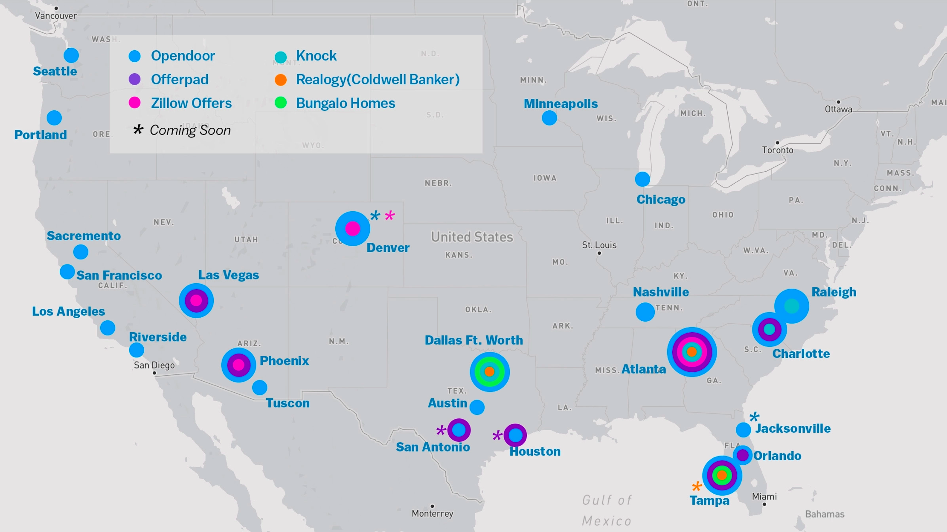
“In established markets like Phoenix, anywhere from 25 percent to 35 percent of active home sellers request an instant offer before selling their home.“
~ Mike DelPrete
  www.ThePowerProgram.com | 631-929-5555

Slide 4
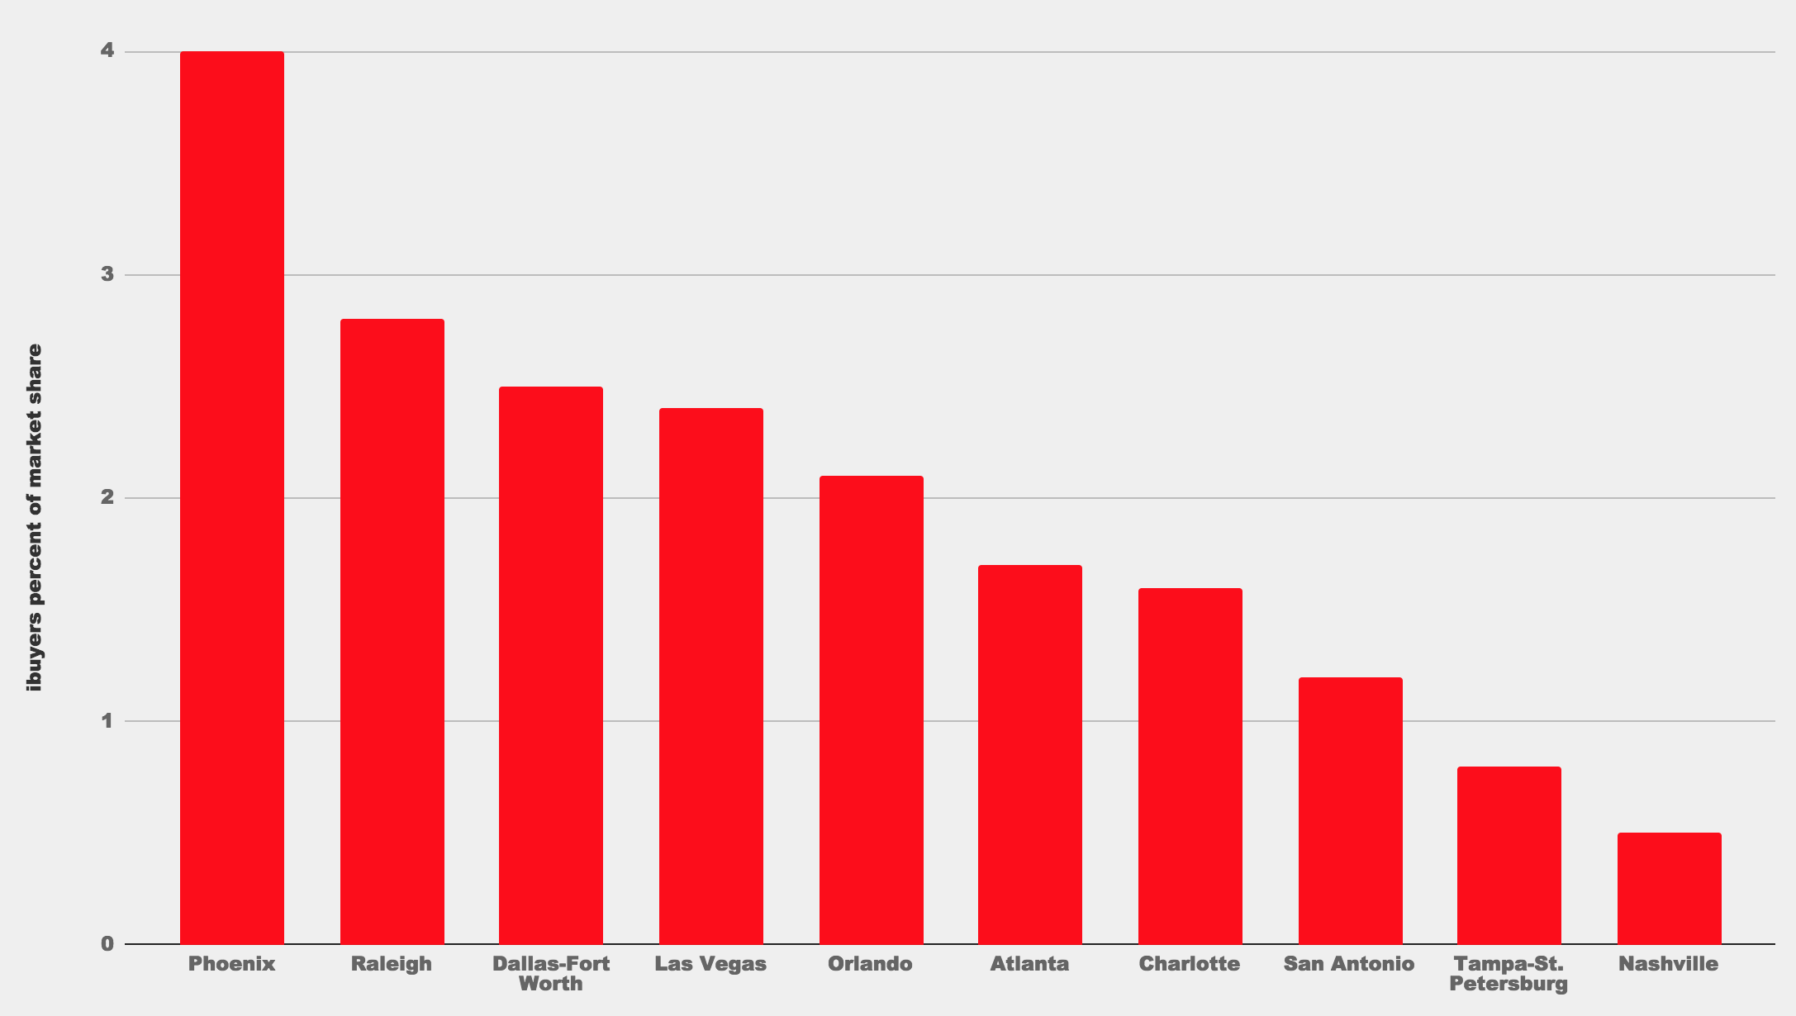
  www.ThePowerProgram.com | 631-929-5555

Slide 5


What Can You Do….
Be Prepared on the Listing Appointment
Educate your local homeowners
  Concentrated Social Media
  Door knocking like someone running for Congress
  Mailings directing to web page (you have permission to use/edit this video)
  Board seminar for the general public
  www.ThePowerProgram.com | 631-929-5555

Slide 6

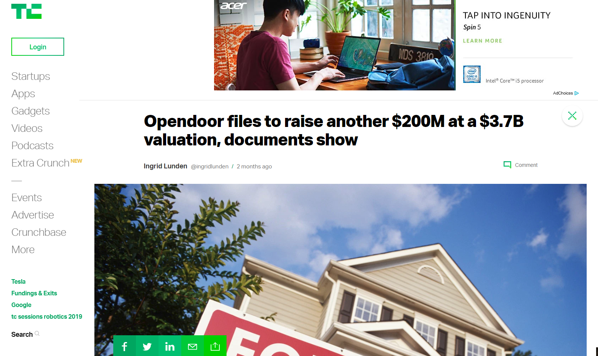



Slide 7

In The Past 4 Years, OpenDoor has Raised…
  www.ThePowerProgram.com | 631-929-5555

Slide 8

Thoughts & Facts
Buyers buy with emotion.
Investors buy for a profit.
iBuyers are investors.
iINVESTORS are offering WAY LESS than what we can sell the homeowners house for.
The longer iINVESTORS hold property, the more it cuts into their profit. Therefore, they have to re-sell it at below market value to sell quickly.
  www.ThePowerProgram.com | 631-929-5555

Slide 9

Purchase Price $400,000
10% Down: $ 40,000
Mortgage: $360,000
Current Value: $450,000
Mortgage: $360,000
Equity: $ 90,000
Sell to iBuyer: $405,000 (10%)
Value: $450,000
Loss Equity: $ 45,000
Loss of Equity: $90,000 - $45,000 = -50%
  www.ThePowerProgram.com | 631-929-5555

Slide 10
Thoughts & Facts
iINVESTORS are representing their best interest. Their focus is making the most money they can from the seller.
WE represent the SELLER’s BEST INTEREST.
They are using MISLEADING FACTS.
  www.ThePowerProgram.com | 631-929-5555

Slide 11

The Good News
iINVESTORS actually show the value of a 6% Commission.
Most of these sales are homeowners who contacted them first before an agent did. Therefore, you need to educate the homeowners in your market.
  www.ThePowerProgram.com | 631-929-5555

Slide 12
The Good News
This should be an easy concern to handle on a listing appointment.
This model will not last.
You can offer to buy the house for what iINVESTORS are offering.
  www.ThePowerProgram.com | 631-929-5555

Slide 13

  www.ThePowerProgram.com | 631-929-5555

Slide 14

Directly from their website…
Your next question is probably, “Okay, but how is an iBuyer going to give me a competitive offer, then turn around and sell my home at a competitive price… and stay in business?” Glad you asked!
While each iBuyer has a different approach to this question, our business model is fee-based. We want to pay a fair market price and charge a service fee similar to the agent commissions in a traditional sale. Our fee averages between 6-7% across our markets, but it can be lower or higher based on how long we estimate it will take to sell your home.
The service we provide is a simpler sale: you get the certainty of a competitive offer, you can avoid months of showings, and you control when you move.
  www.ThePowerProgram.com | 631-929-5555

Slide 15
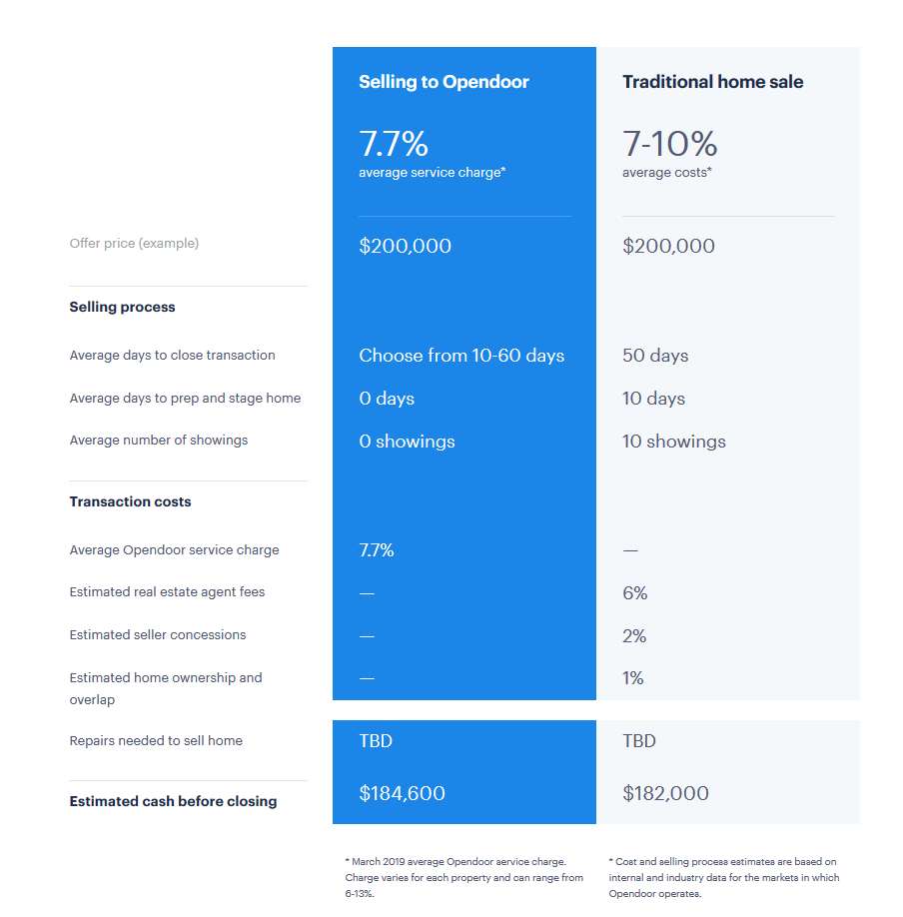

  www.ThePowerProgram.com | 631-929-5555

Slide 16
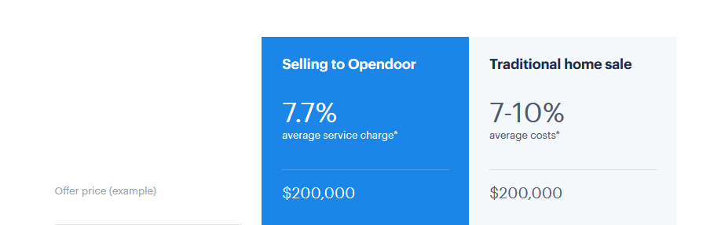
$220,000
  www.ThePowerProgram.com | 631-929-5555

Slide 17
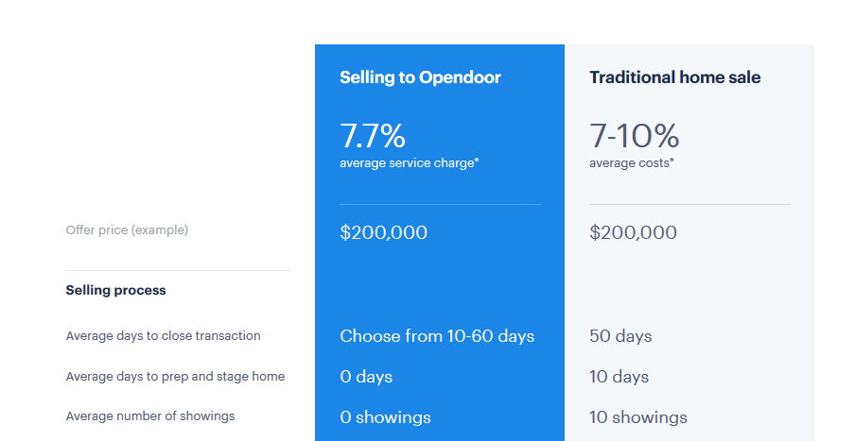
$220,000
  www.ThePowerProgram.com | 631-929-5555

Slide 18
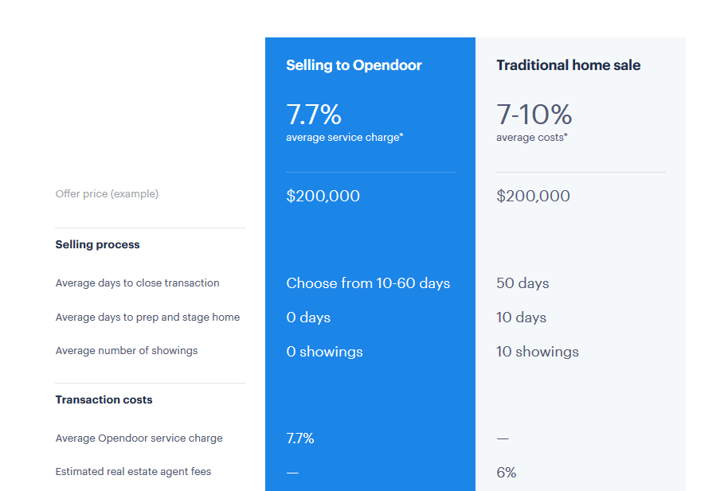
$220,000
  www.ThePowerProgram.com | 631-929-5555

Slide 19
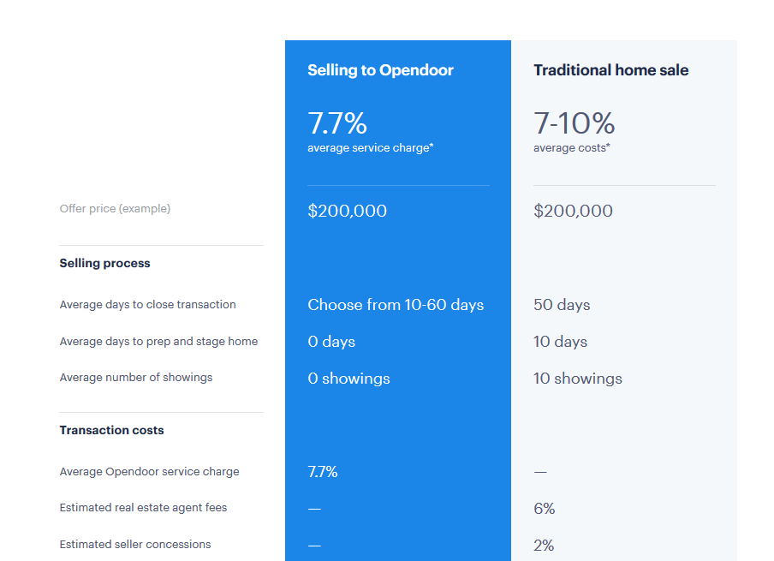

$220,000
  www.ThePowerProgram.com | 631-929-5555

Slide 20
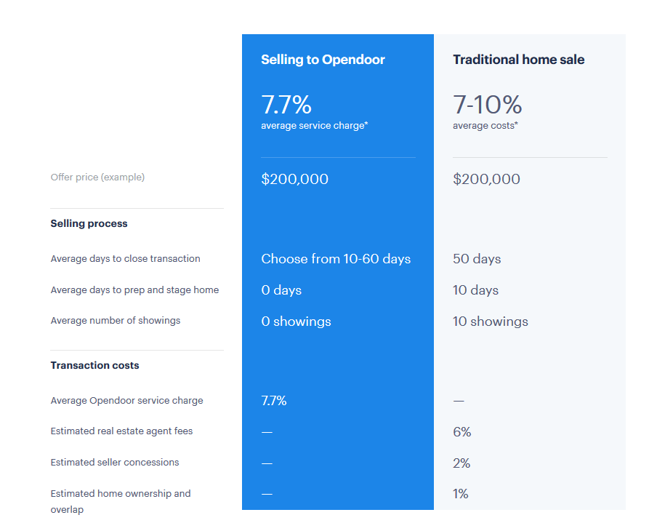
$220,000
  www.ThePowerProgram.com | 631-929-5555

Slide 21
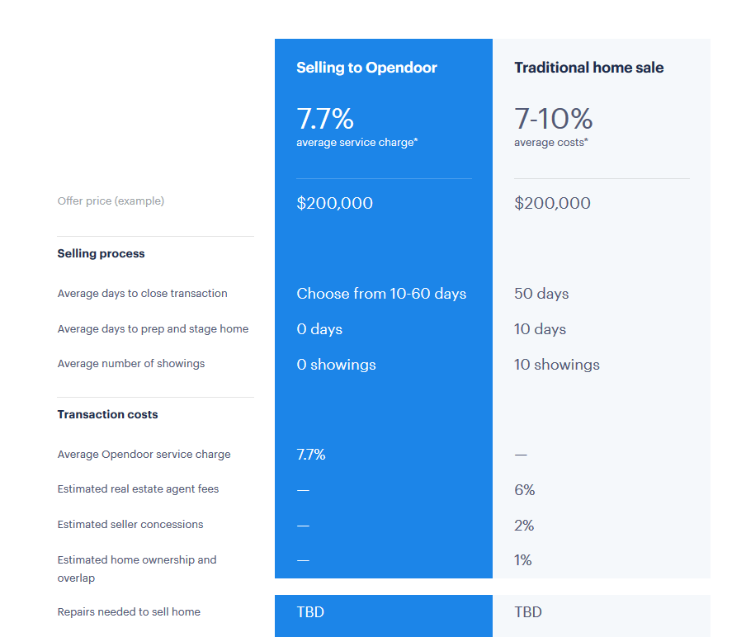
$220,000
  www.ThePowerProgram.com | 631-929-5555

Slide 22
COST $22,200 To Save 10-40 days
6%
$220,000
$206,800
  www.ThePowerProgram.com | 631-929-5555

Slide 23
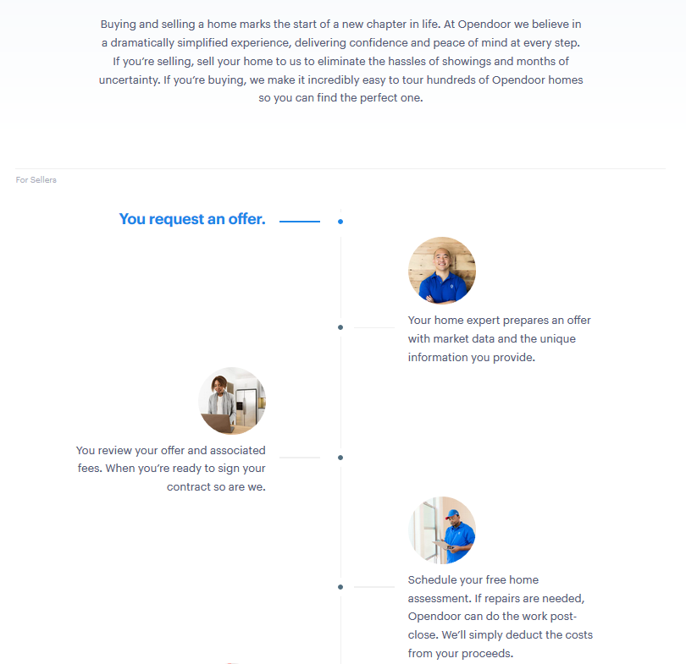
The buyer tells you what they say it’s worth
Sellers always write contract in traditional sales
You pay the repairs they tell you they want repaired
  www.ThePowerProgram.com | 631-929-5555

Slide 24
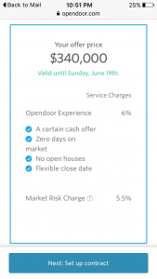
11.5% Commission

Slide 25


Slide 26
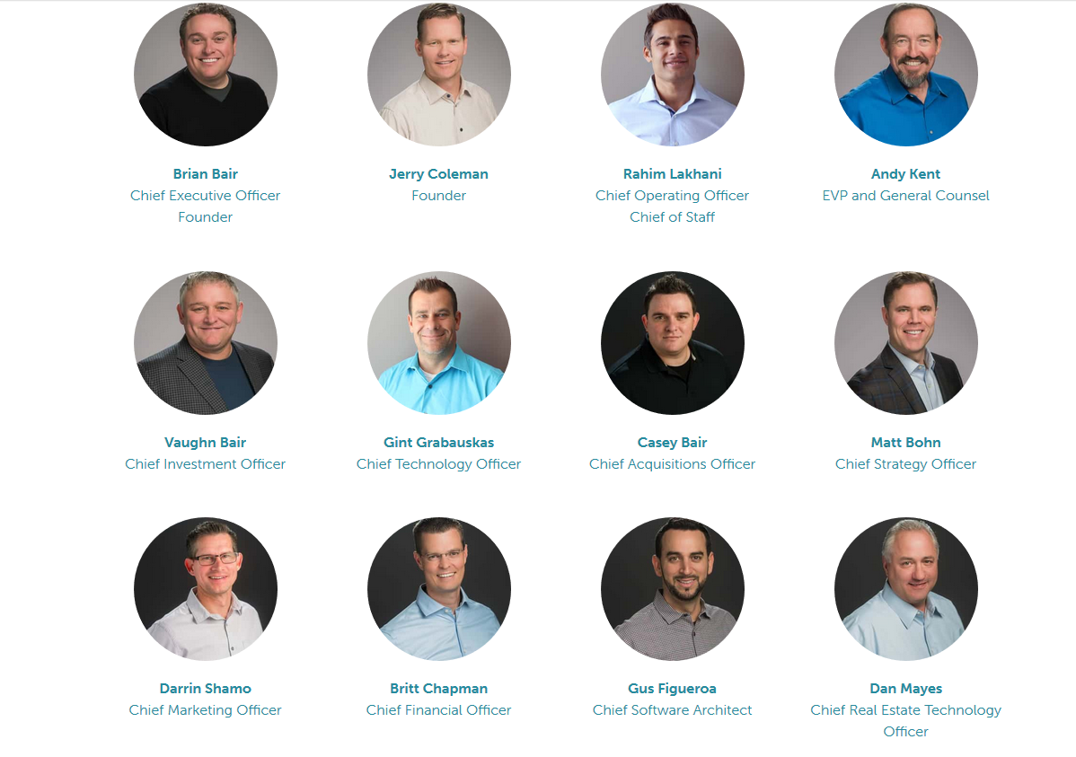

Slide 27
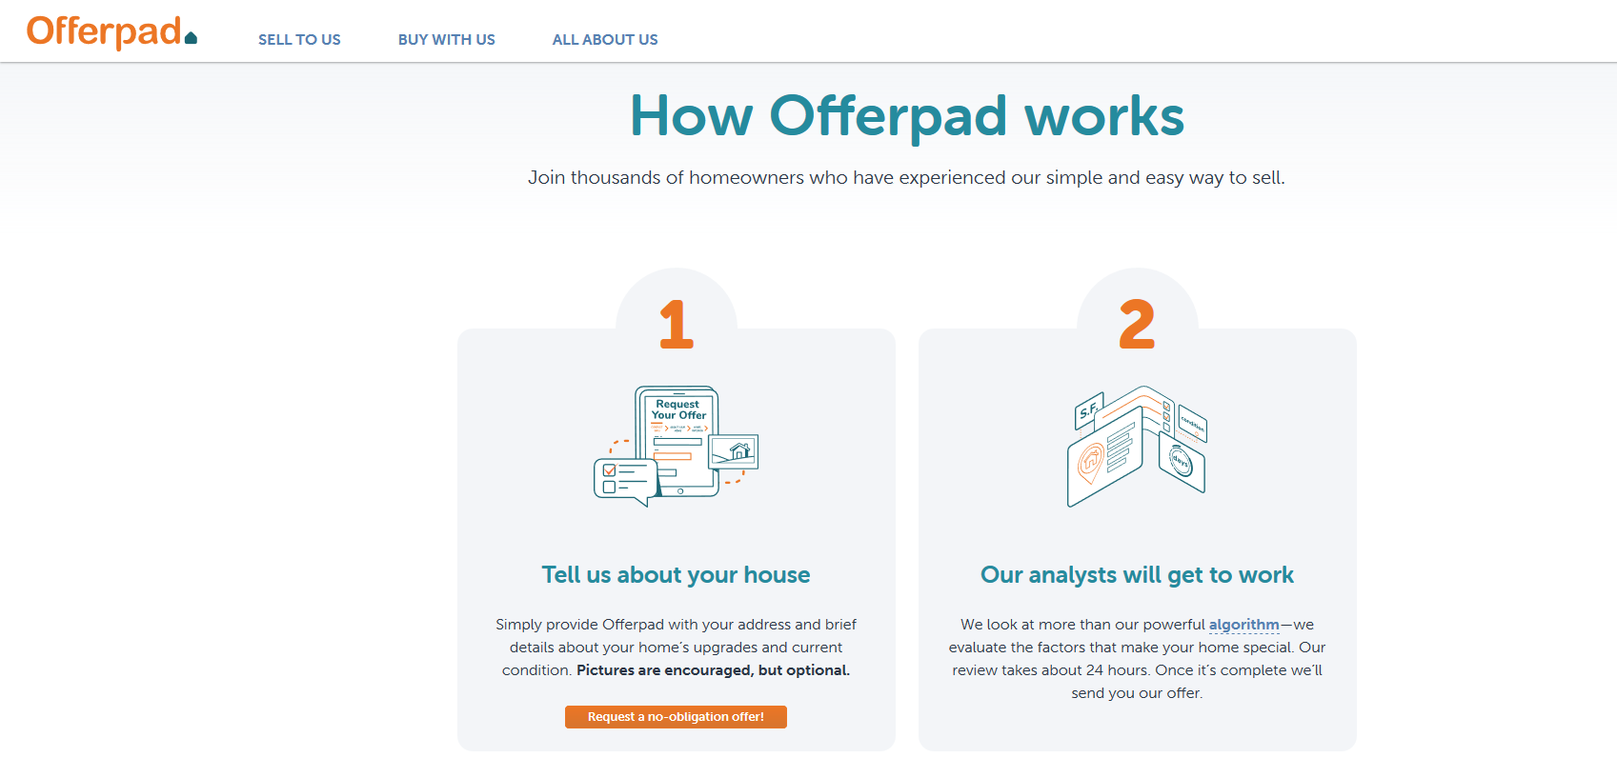
The buyer tells you what they say it’s worth
  www.ThePowerProgram.com | 631-929-5555

Slide 28
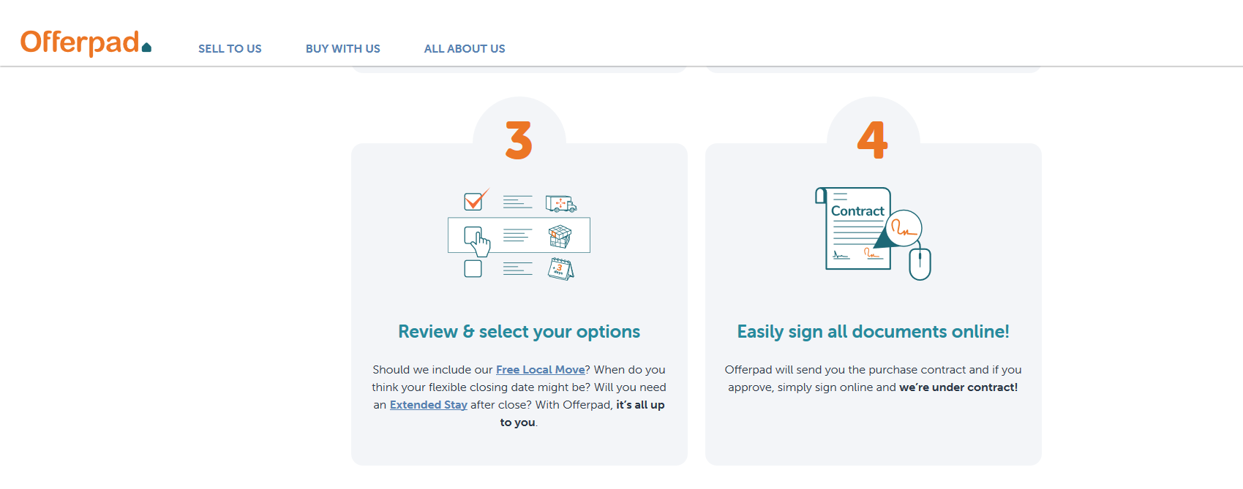
Sellers always write contract in traditional sales
  www.ThePowerProgram.com | 631-929-5555

Slide 29
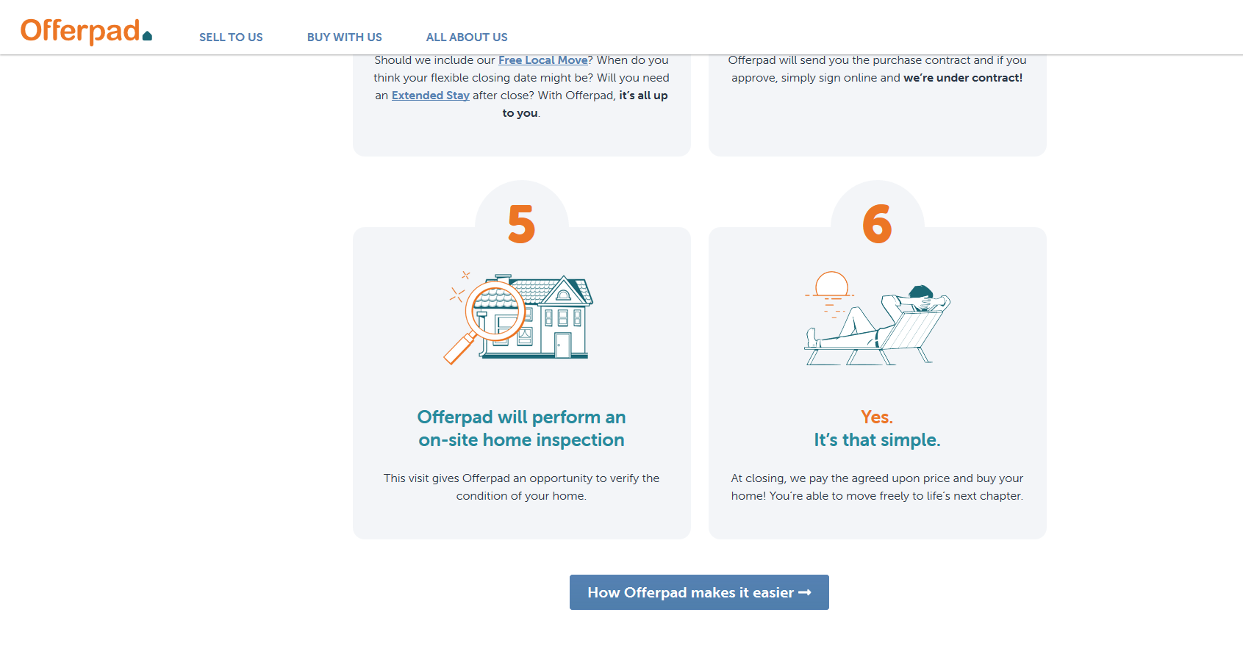
You pay the repairs they tell you they want repaired
  www.ThePowerProgram.com | 631-929-5555

Slide 30

  www.ThePowerProgram.com | 631-929-5555

Slide 31
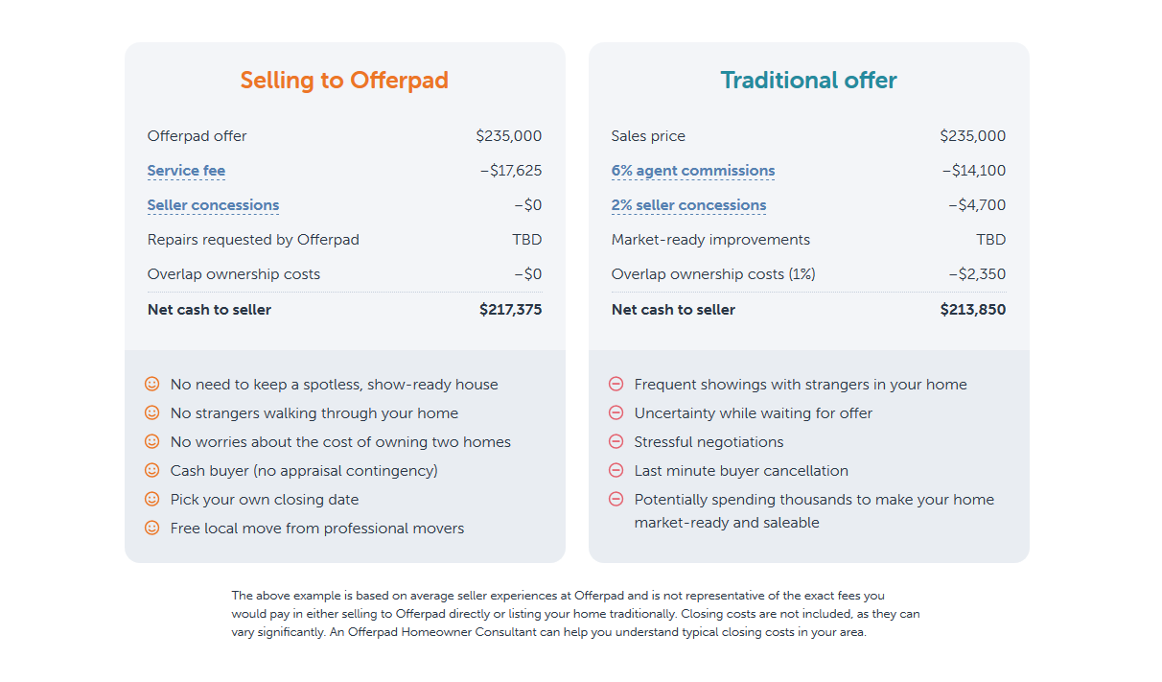
$260,000
$15,600
$244,400
Extra $27,025
  www.ThePowerProgram.com | 631-929-5555

Slide 32
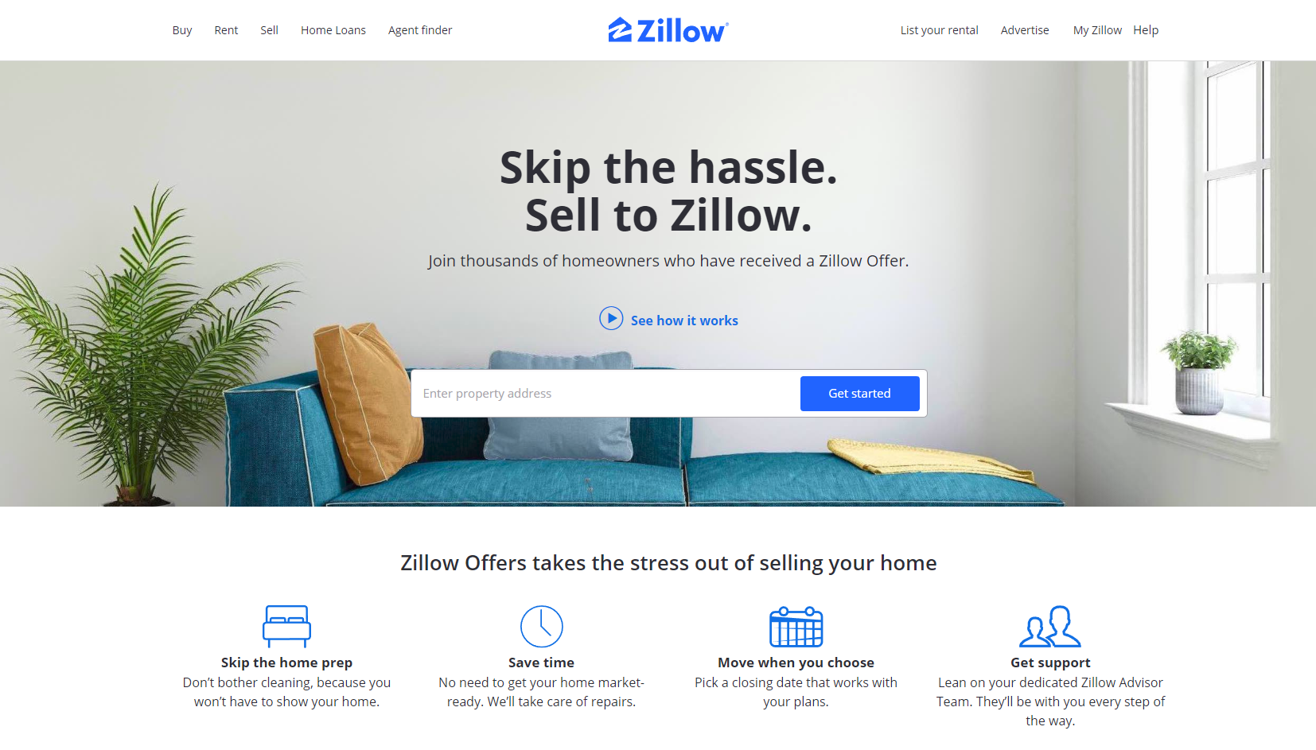

Slide 33
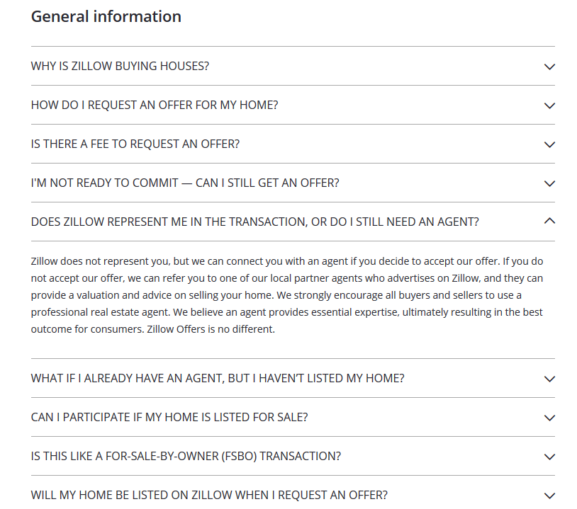
  www.ThePowerProgram.com | 631-929-5555

Slide 34
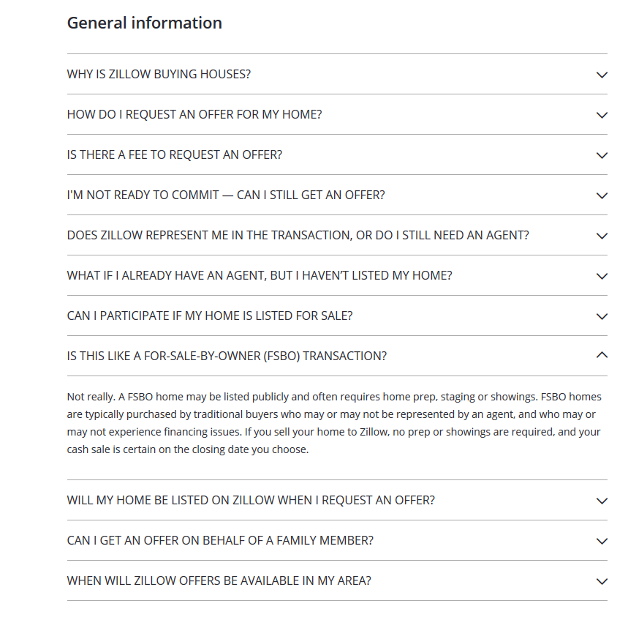
If the seller does not have representation, then they are a FSBO negotiating with a corporation
  www.ThePowerProgram.com * 631-929-5555

Slide 35
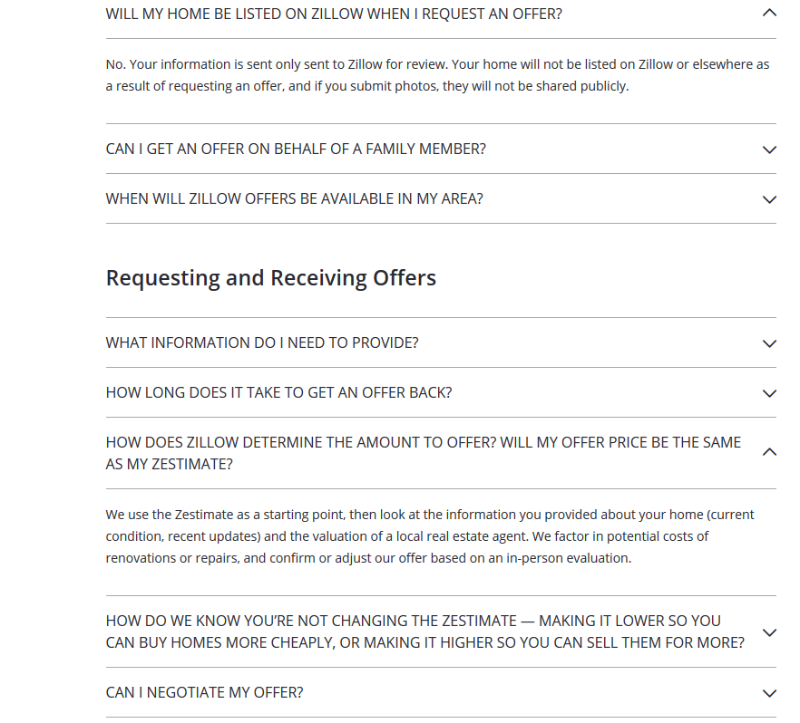
Zillow is NOT going to pay you the Zestimate - they are paying LESS
  www.ThePowerProgram.com * 631-929-5555

Slide 36
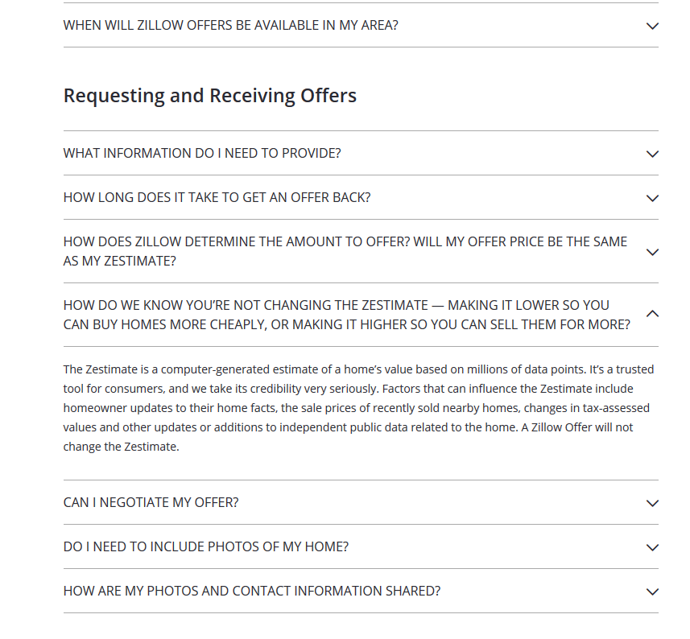
In other words, they are saying their purchase offer will be LESS than the fair market value
  www.ThePowerProgram.com | 631-929-5555

Slide 37
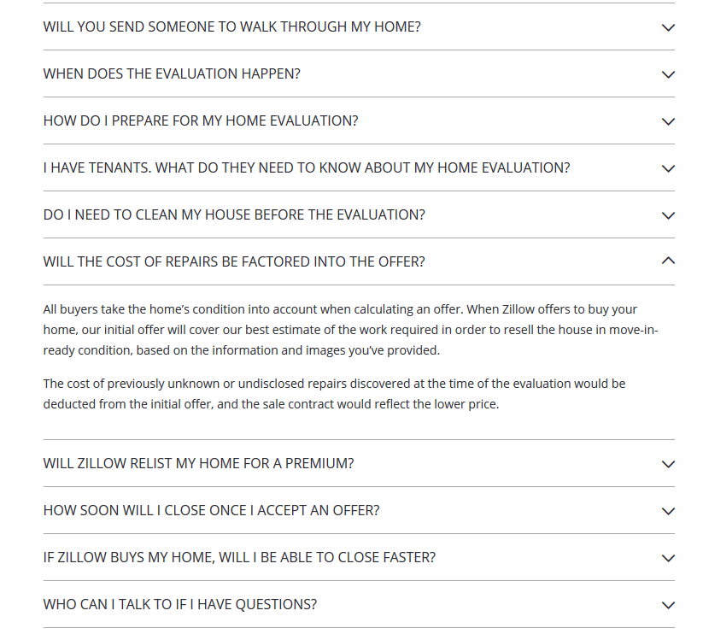
Repairs they want the seller to pay so they can flip the house for a profit
  www.ThePowerProgram.com | 631-929-5555

Slide 38
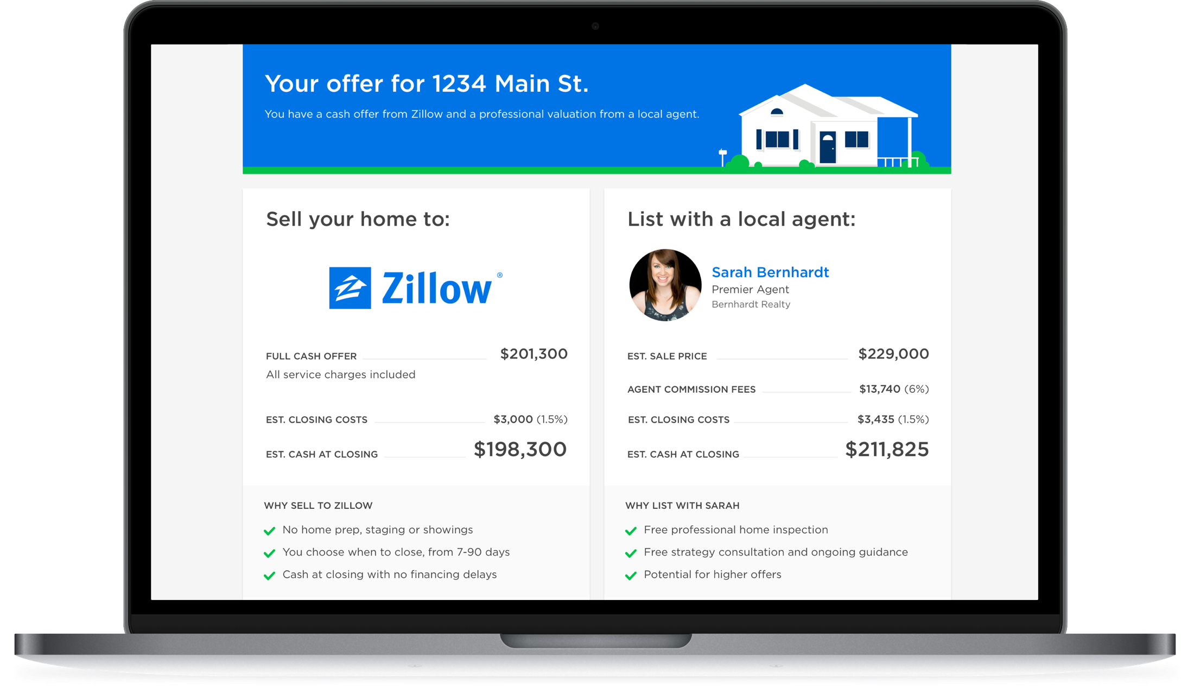
An Honest Example. With a real estate agent,
sellers WILL net more money.
  www.ThePowerProgram.com | 631-929-5555

Slide 39

Points to Make to Sellers
If it sounds too good to be true, it is!
They are looking out for THEIR interest, not YOURS!
You would be selling to them based on what THEY tell you it’s worth!
Saying YOU pay a seller’s concession fee with an agent is a marketing lie!
They are buying to flip it for a profit AND for making you pay them a 6-13% Commission, which they call a Service Fee.
In addition to their Commission, another Commission called a Market Risk Fee, another 2-6%.
They are making you to pay for repairs THEY want done so they can make money on you.
They are controlling you and the process.
  www.ThePowerProgram.com | 631-929-5555

Slide 40
iBuyer
The Worst Thing To Happen To Homeowners
  www.ThePowerProgram.com | 631-929-5555

Slide 41


iBuyer Tells Seller What Their House is Worth ($176,000)
Seller Receives $176,000 minus Repairs
iBuyer Sells $210,000
iBuyer Contracts With Seller at Deep 20-40% Discount
Ask Seller to Pay for Repairs & Close
Put Back On Market at Quick-Sale Price for a Profit
Traditional Value $220,000

